Slide 1
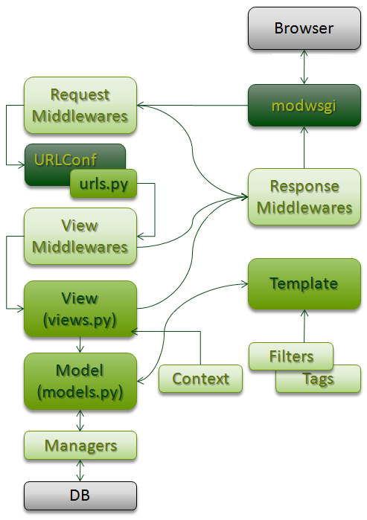
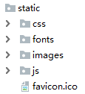
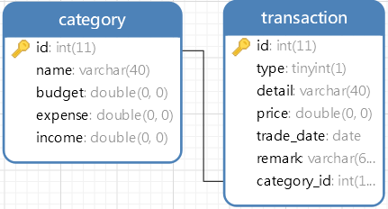
IMPLEMENTATION & TestING
import pytest
class Test:
def test_add_category(self):
……
def test_delete_transaction(self):
……
urlpatterns = [
path('', views.home),
re_path(r"^index", views.index),
re_path(r"^expense", views.expense),
re_path(r"^homeDetail", views.home_detail),
re_path(r"^addCategory", views.add_category),
……
]
index.html
expense.html
import.html
addDetail.html
……
def add_category(request):
……
return JsonResponse({"result": data})
……
$.ajax({
url: "/addCategory",
type: “POST",
data: data: {name: name, budget: budget},
success: function (data) {
// condition …
location.href = "/expense";
}
});

